Slide 1
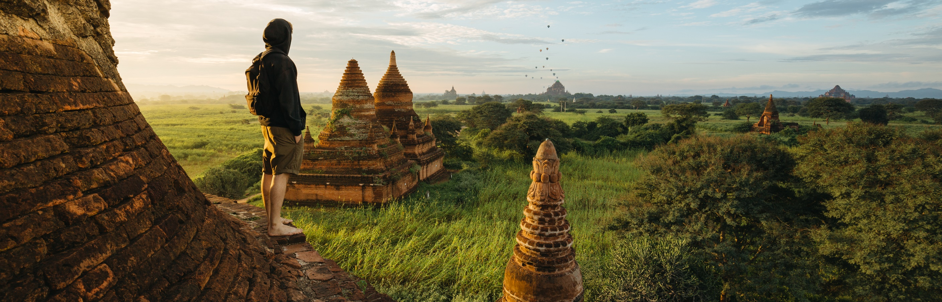
Safest Solutions Group
Travel Guide: The better way enjoy your world travel adventure

Slide 2

Choose an Experience
Adventure
Enthusiasm
Discovery

Slide 3

Travel Budget
BON VOYAGE!

Slide 4

Transportation
Car
Ride Share
Taxi
Rental
Air
Int.
Domestic
Rail
Railway

Slide 5
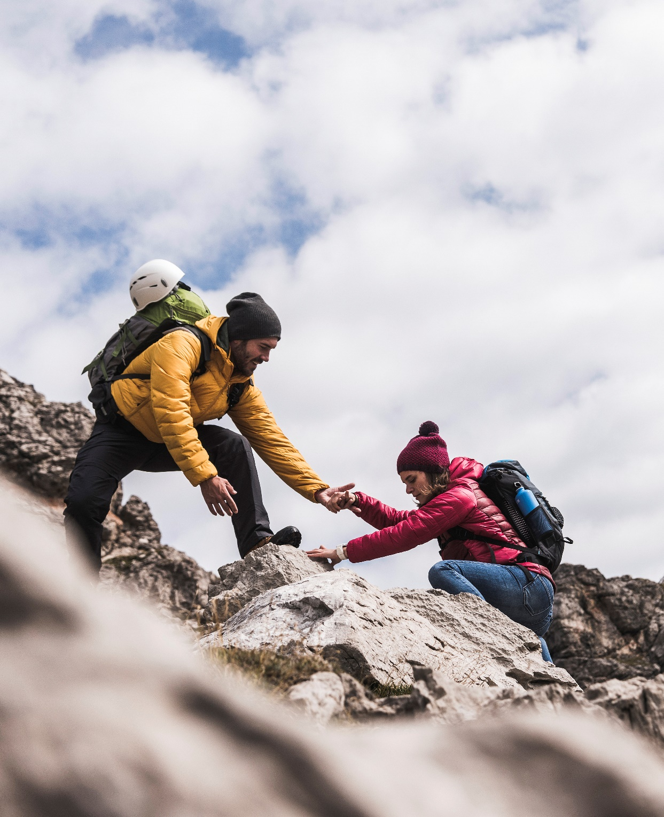
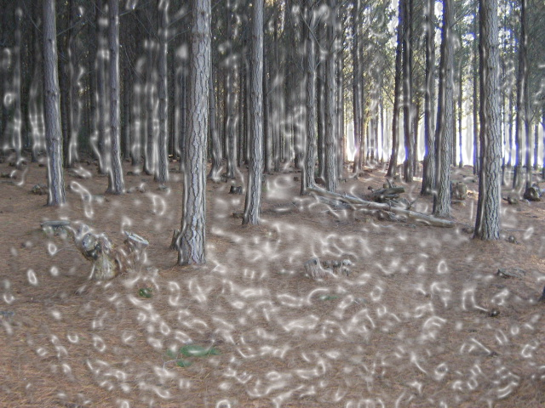
Thank You
furkiddz@safestsol.ni
Notes:
Thank you for being part of our exciting venture today. We will be in touch to explain the route and all the arrangements going forward.
Contact our lead climber on safestsol@gmail.com

